Slide 1
Wind Farm Regulations 2021 Public Hearing Presentation
4/29/2021
Wind Farm Regulations 2021
Public Hearing Presentation
Ashland, MO

Slide 2
Welcome & Thank you
Please follow all guidance from the Boone County Public Health Order and Southern Boone R-1 School District regarding the COVID-19 pandemic.
We ask that all persons wear a face mask and maintain 6-feet of physical distance from other parties when possible.
Chairman Opening Statement
Wind Farm Regulations 2021
Public Hearing Presentation

Slide 3
Purpose
The intent of the regulations being discussed tonight is to provide a fair process for the County to evaluate and decide, whether a proposed windfarm should be allowed in Boone County and the manner in which the windfarm would be developed and operated. The process includes two separate decision-making processes.
The first step will be to decide whether to create a Wind Energy Conversion Overlay District (WECOD). The process to establish a WECOD in Boone County is extensive and requires the applicant to obtain the consent of a super-majority of property owners within the proposed WECOD and demonstrate to the Planning and Zoning Commission and the County Commission that the proposal meets or exceeds local standards. The Planning and Zoning Commission and the County Commission will each conduct at least one public hearing.
The second step occurs only after a WECOD is established. In this step, the proponent will have to obtain a Conditional Use Permit (CUP) from the County Commission for each wind turbine. Public hearings are required at this step too. Only after the CUP is issued, can the County issue a building permit for a wind turbine.
Wind Farm Regulations 2021
Public Hearing Presentation

Slide 4
Process overview
Express interest in establishing WECS-C (Commercial Wind Farm)
Step 1: Apply for Wind Energy Conversion Overlay District (WECOD)
Step 2: Apply for Conditional Use Permits for towers and accessory structures within WECOD
Applicant must meet all criteria for approval, pay fees, and meet established timeline
Wind Farm Regulations 2021
Public Hearing Presentation

Slide 5
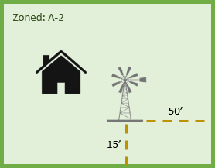
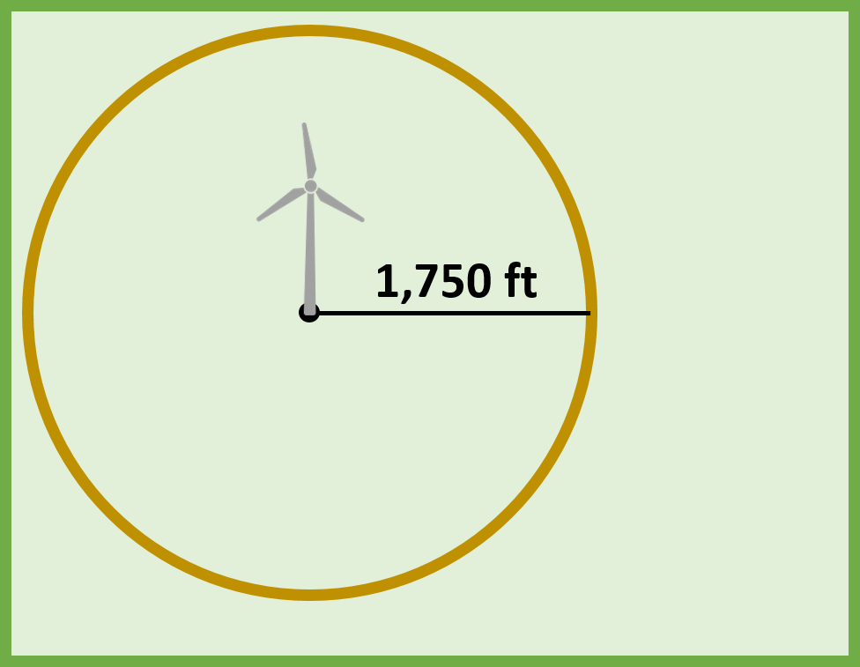
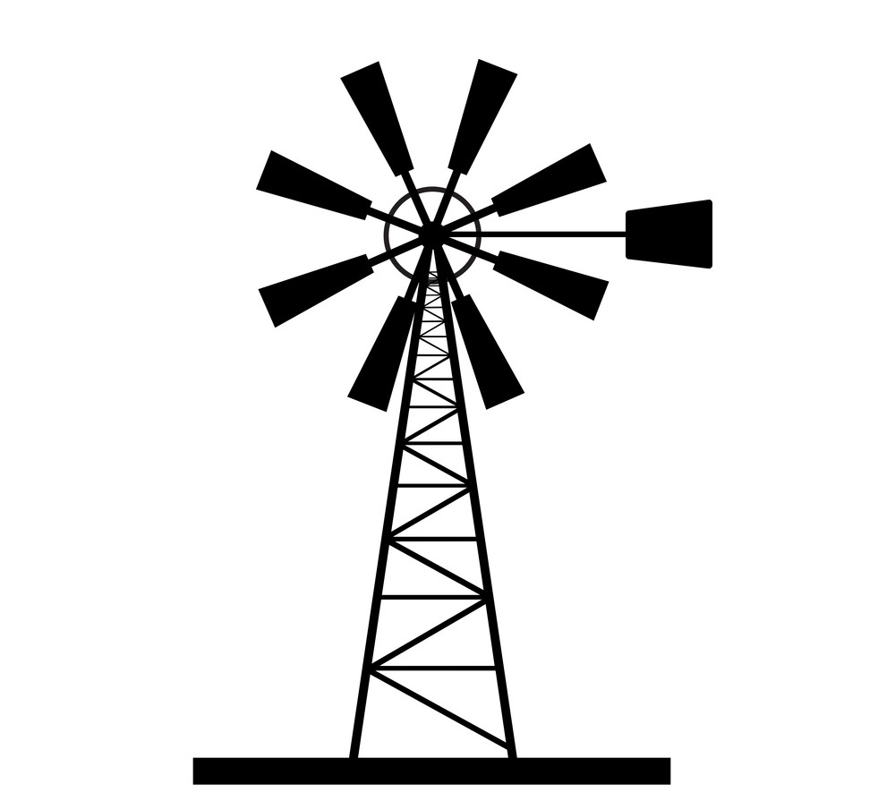
Clarification
Existing Regulations
Proposed Regulations
WECS-S Small Residential Turbines
WECS-C Commercial Wind Turbines
On-site personal use
Location: Agriculture or Residential Zoned
Neighbor support not necessary
CUP required IF height 100’ – 175’
Mailed notice to all property owners within 1000’
Off-site commercial use
Location: Agriculture or Industrial Zoned
Neighbors would need to support
WECOD required
CUP required
Setback: 6’- 50’
Setback: 1750’
not to scale
Height: 35’
not to scale
Height: 355’
In excess: +1’ height = +1’ setback
Wind Farm Regulations 2021
Public Hearing Presentation

Slide 6
WECOD (Wind Energy Conversion Overlay District)
WECOD is composed of two parts:
Primary District
Buffer Area
Primary District:
This is the area wind turbines may be located in. It’s based on location of property proposing to establish a Wind Farm. The minimum size is 640 Acres (4 contiguous Quarter-Sections)
Buffer Area:
NO wind turbines may be constructed here. The buffer extends outward from the perimeter of the Primary District to 1,320 feet (1/4 mile)
1,320’
640 Acres
1,320’
640 Acres
Wind Farm Regulations 2021
Public Hearing Presentation

Slide 7
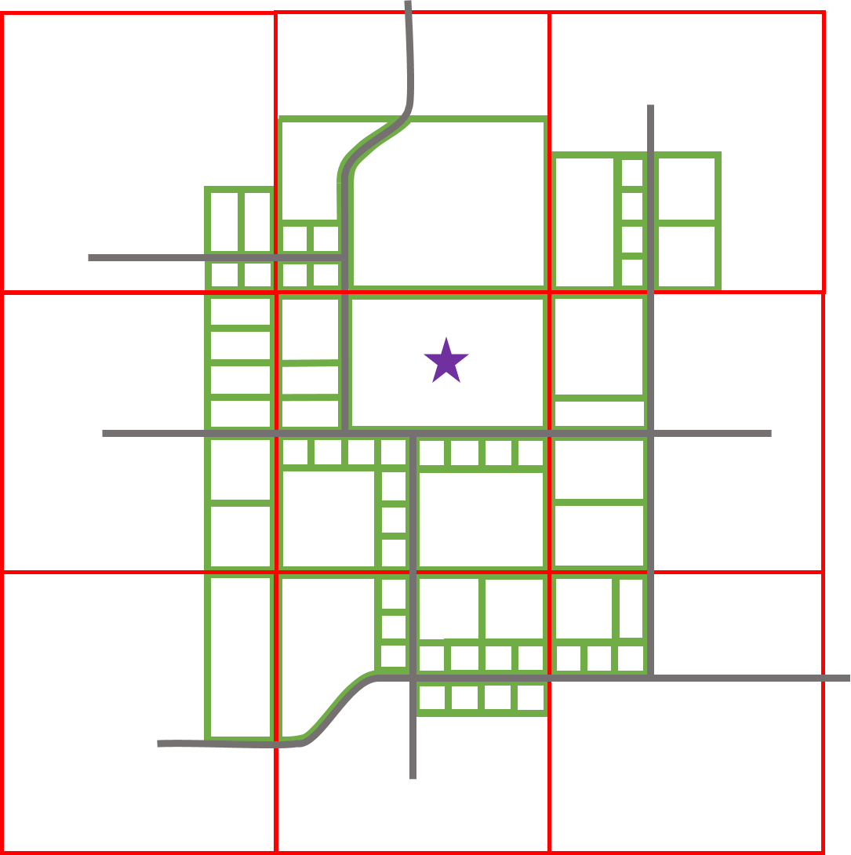
WECOD (Wind Energy Conversion Overlay District)
Example: Farmer STAR
KEY
= Property Line
= Section
= Farmer STAR Property
= Roads
Wind Farm Regulations 2021
Public Hearing Presentation

Slide 8
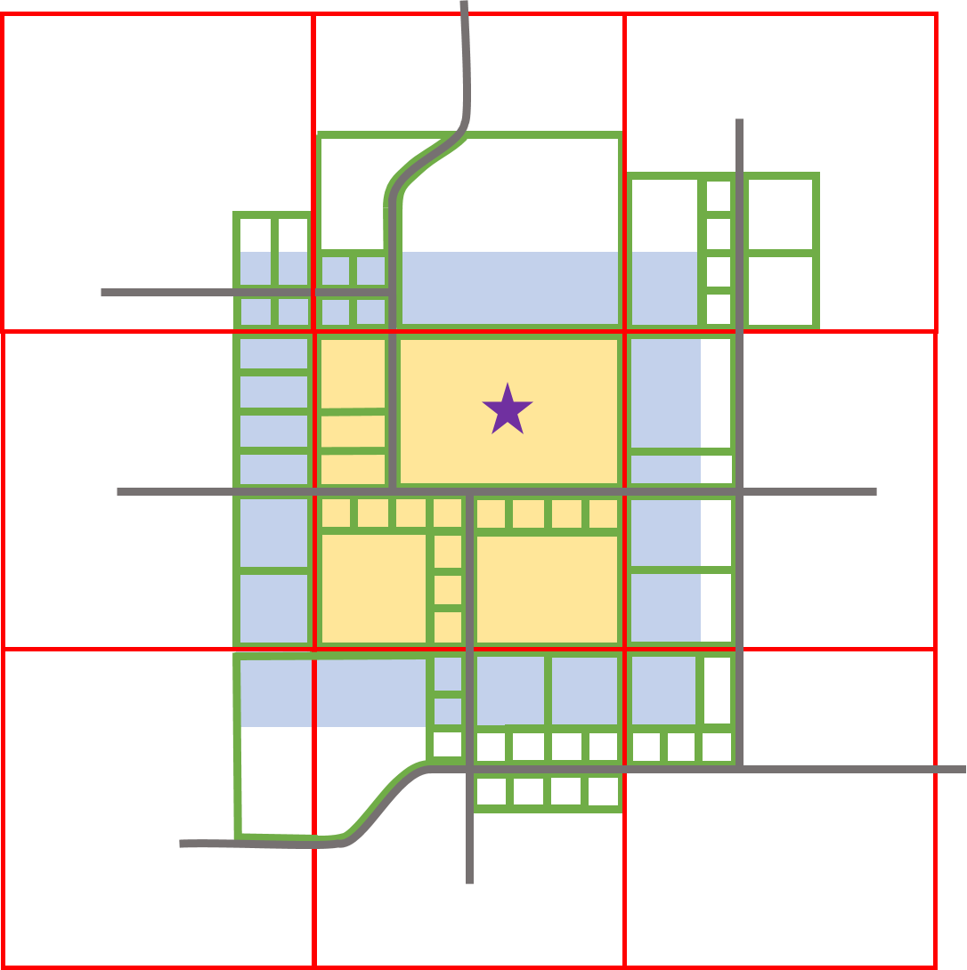
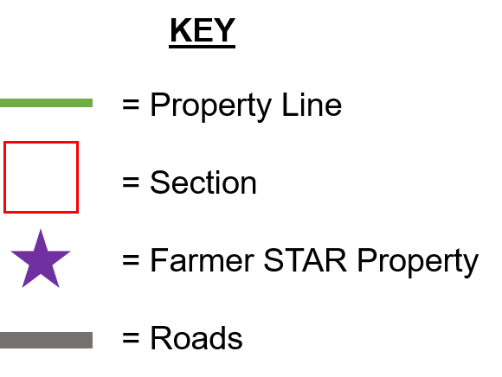
WECOD (Wind Energy Conversion Overlay District)
Example:
If Farmer STAR wanted to establish a Commercial Wind Farm on his 240-acre piece of land he would need to apply for a WECOD that contains 4 contiguous quarter sections.
Primary District
16 Properties totaling 640 Acres
Buffer Area
26 Properties totaling 800 Acres
Wind Farm Regulations 2021
Public Hearing Presentation

Slide 9
WECOD (Wind Energy Conversion Overlay District)
Example:
Farmer STAR would need to submit a petition to the Director of Resource Management which includes the notarized signatures of:
A.)
B.)
C.)
The owners of at least 75% of the total acreage within the primary district
at least 67% of the property-owners within the primary district
at least 67% of the property-owners within the buffer area
Wind Farm Regulations 2021
Public Hearing Presentation

Slide 10
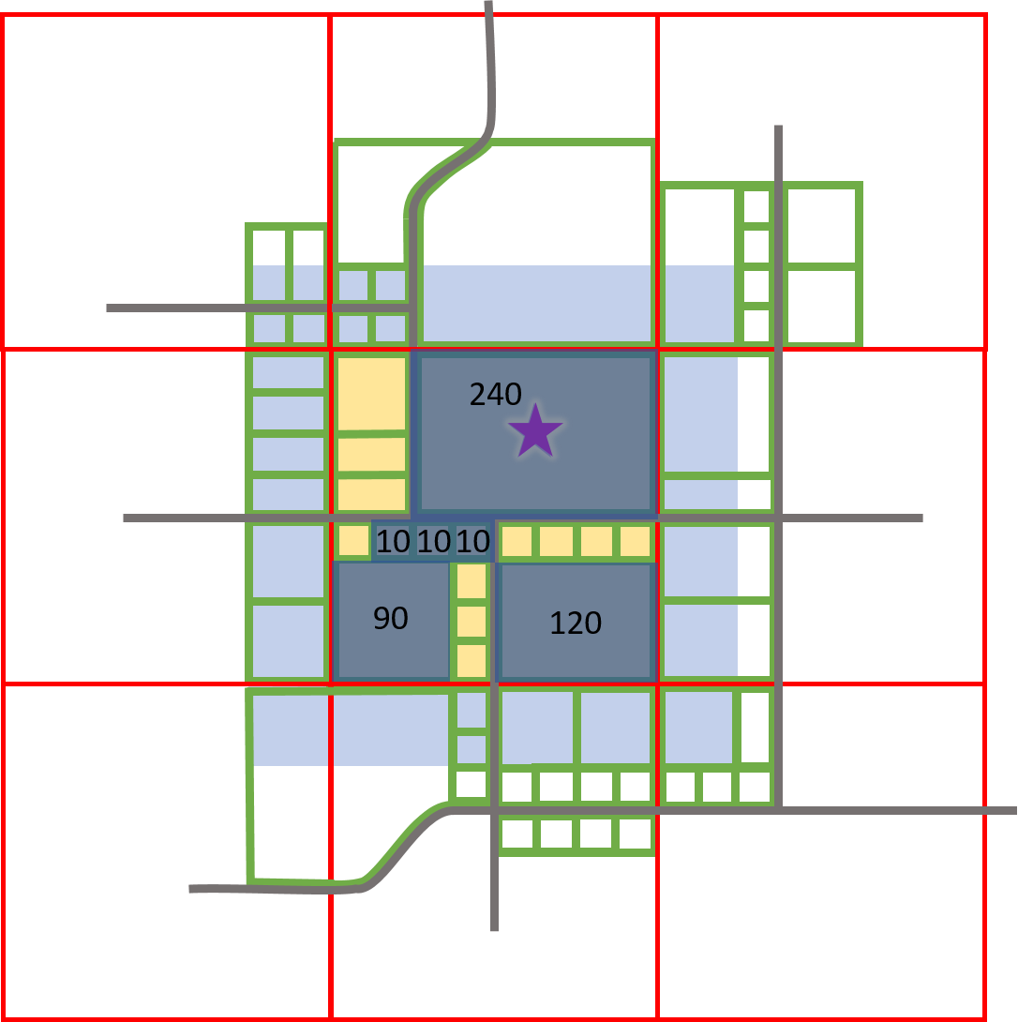
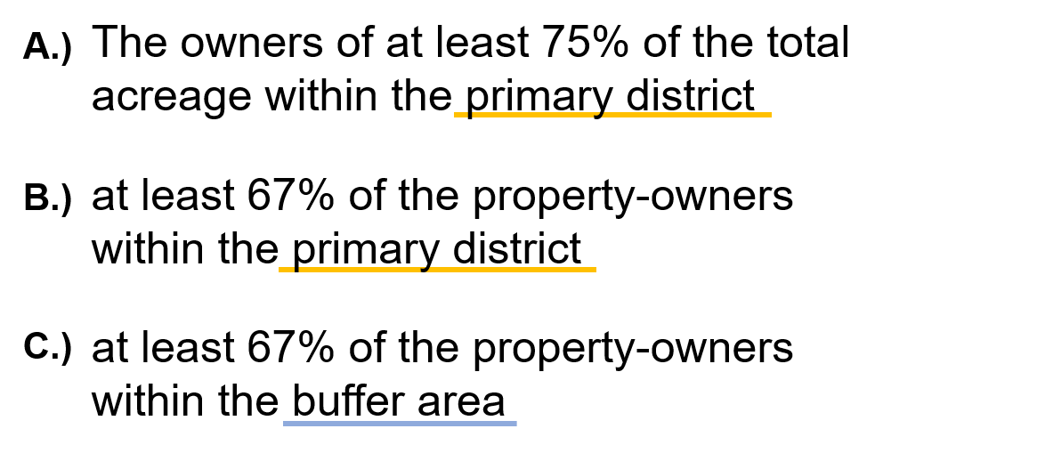
WECOD (Wind Energy Conversion Overlay District)
Example:
Farmer STAR would need to submit a petition to the Director of Resource Management which includes the notarized signatures of:
Equation:
Primary District includes: 640 Acres
640 x 75% = 480 Acres ~ Petition signers must own at least 480 Acres
Wind Farm Regulations 2021
Public Hearing Presentation
6 owners (240+120+90+10+10+10) = 480

Slide 11
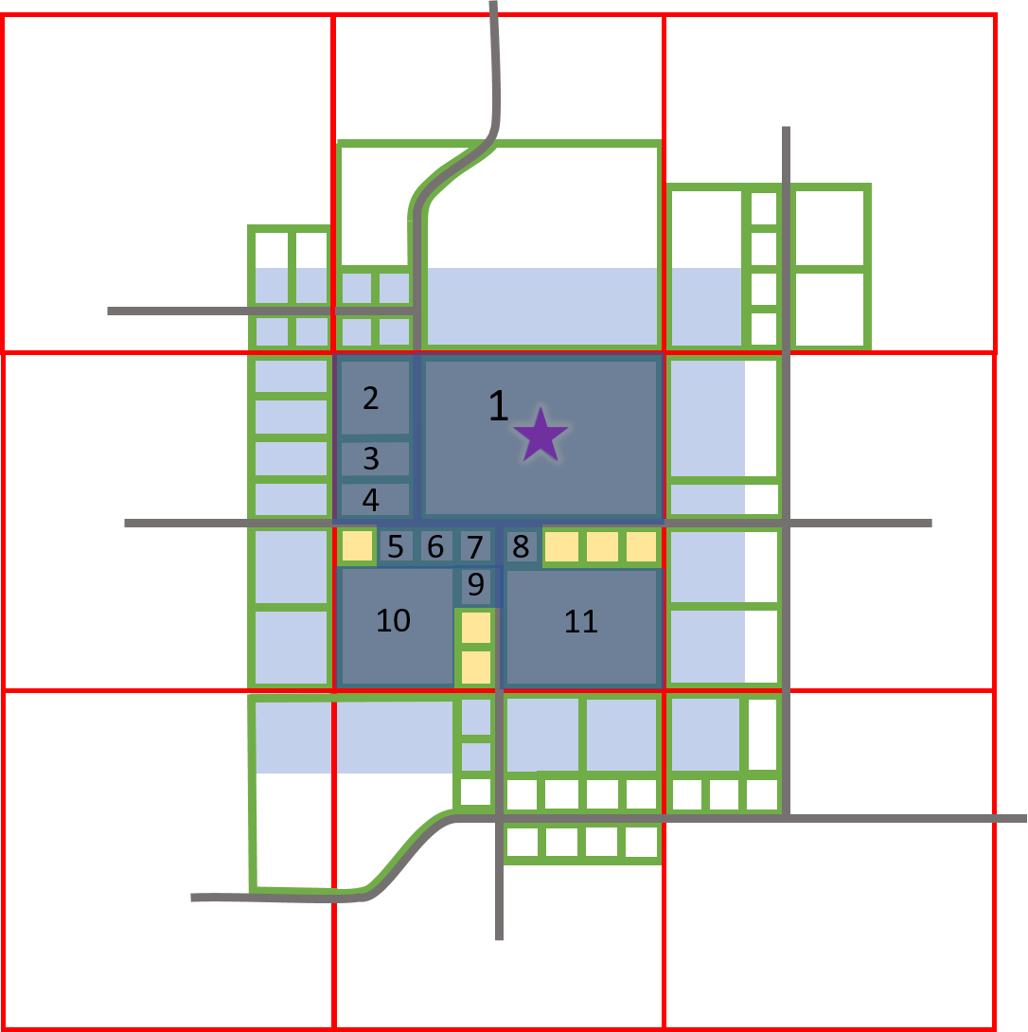
WECOD (Wind Energy Conversion Overlay District)
Example:
Farmer STAR would need to submit a petition to the Director of Resource Management which includes the notarized signatures of:
Equation:
Primary District includes: 17 owners (including Farmer STAR)
17 x 67% = 11.39 ~ rounds to 11 property-owners must sign petition
Wind Farm Regulations 2021
Public Hearing Presentation

Slide 12
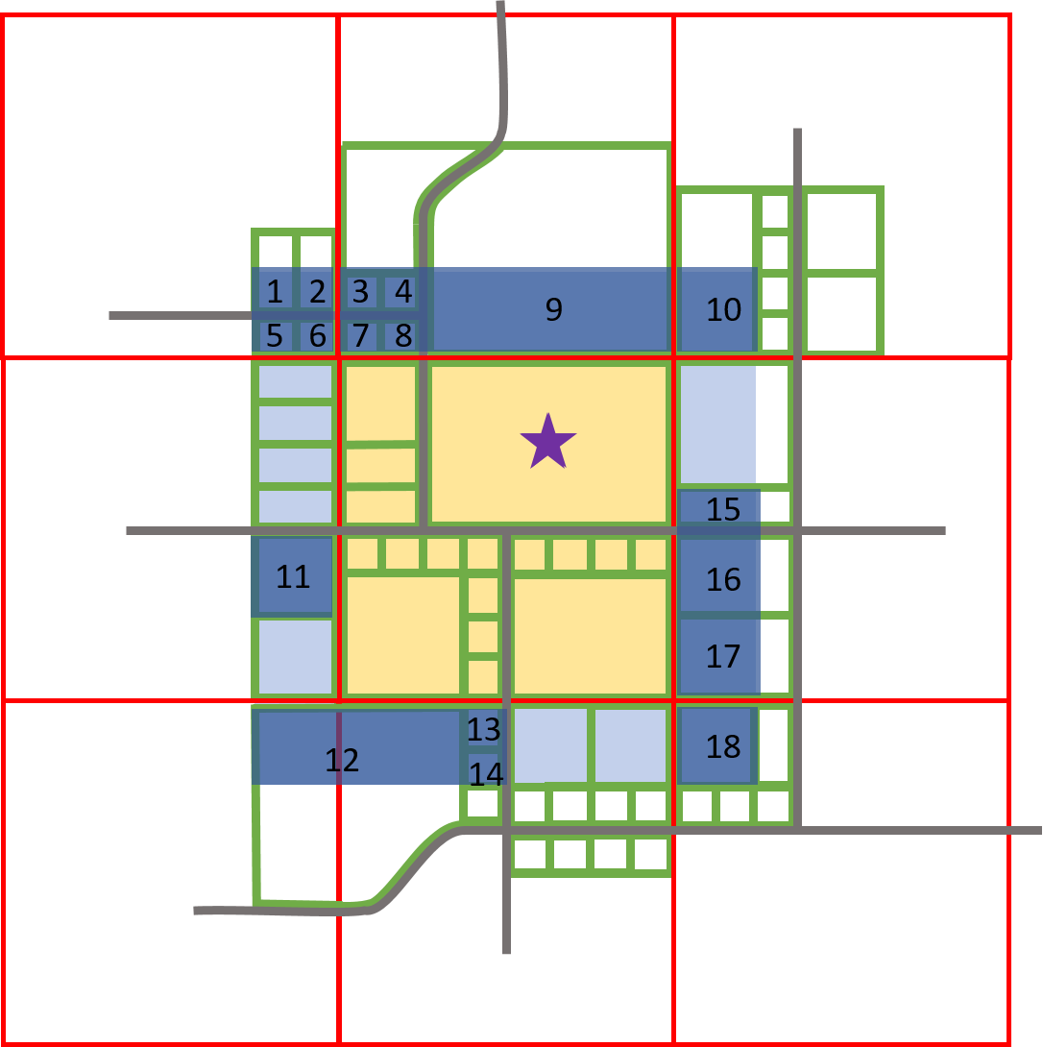
WECOD (Wind Energy Conversion Overlay District)
Example:
Farmer STAR would need to submit a petition to the Director of Resource Management which includes the notarized signatures of:
Equation:
Buffer Area includes: 26 owners
26 x 67% = 17.72 owners ~ rounds up to 18 owners must sign petition
Wind Farm Regulations 2021
Public Hearing Presentation

Slide 13
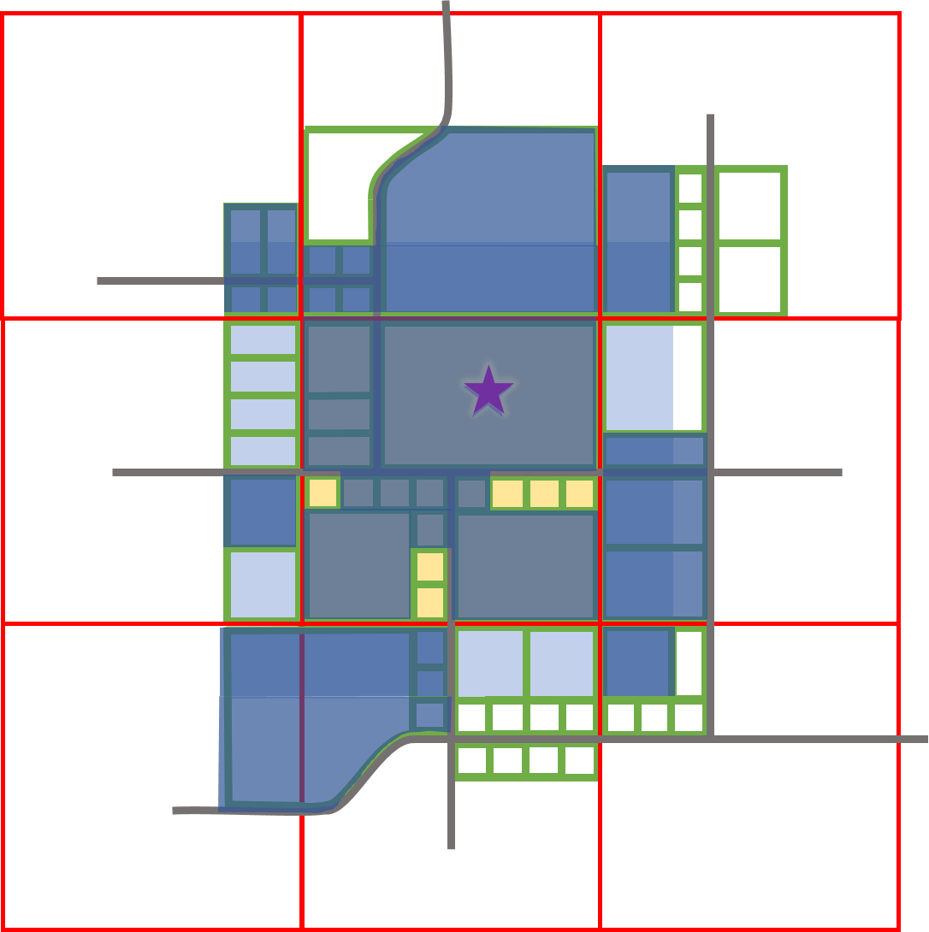
WECOD (Wind Energy Conversion Overlay District)
Farmer STAR must meet ALL of the signature requirements in order to be considered for a WECOD
Example:
A.)
B.)
C.)
The owners of at least 75% of the total acreage within the primary district
at least 67% of the property-owners within the primary district
at least 67% of the property-owners within the buffer area
Wind Farm Regulations 2021
Public Hearing Presentation

Slide 14
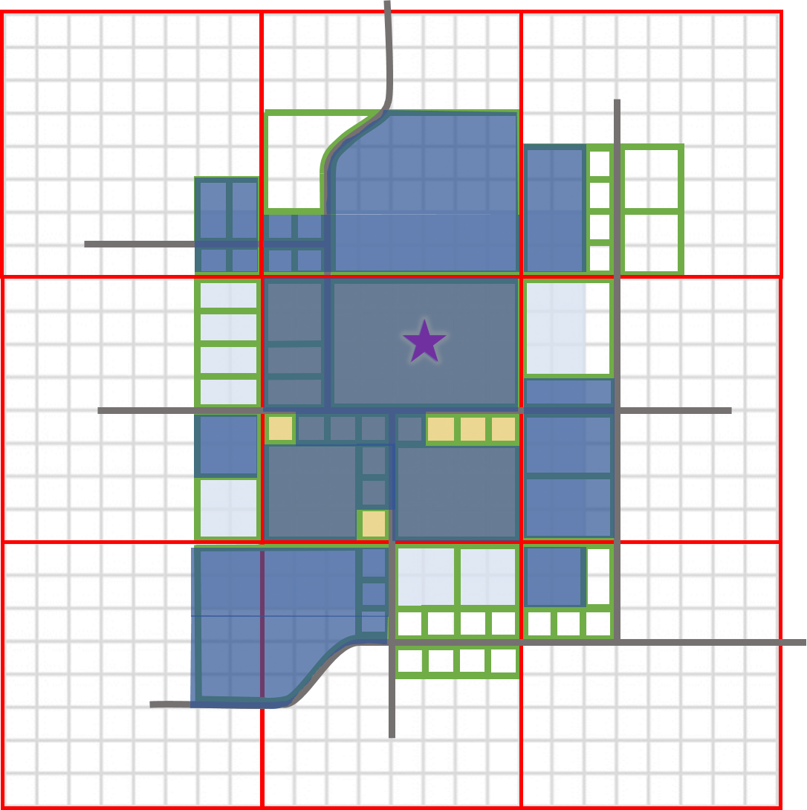
WECOD (Wind Energy Conversion Overlay District)
IF Farmer STAR can get the required signatures on the petition, THEN he would need to meet series of criteria
Example:
Submit Complete Application
Pay Fees
Notify Neighbors
Meet Approval Standards
Meet Siting and Performance Standards
Wind Farm Regulations 2021
Public Hearing Presentation

Slide 15
WECOD (Wind Energy Conversion Overlay District)
Example:
Farmer STAR would need to submit a completed application including an:
Overlay District Plan
includes, but not limited to:
Legal Description of land
Aerial Photography of region
Location and dimensions of existing structures
Location and dimensions of proposed structures
All environmentally sensitive areas within WECOD
Wind Farm Regulations 2021
Public Hearing Presentation

Slide 16
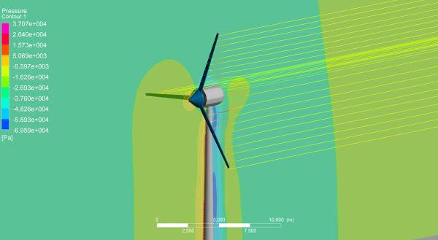
WECOD (Wind Energy Conversion Overlay District)
Example:
Farmer STAR would need to submit a completed application including a:
Computer Generated Visual Simulation
includes, but not limited to:
Impacts from turbine blades on surrounding area
Viewpoints from houses who did not sign the Petition for Application
Viewpoints from houses 1000’ outside of WECOD boundary
Up to 12 additional viewpoints
Wind Farm Regulations 2021
Public Hearing Presentation

Slide 17
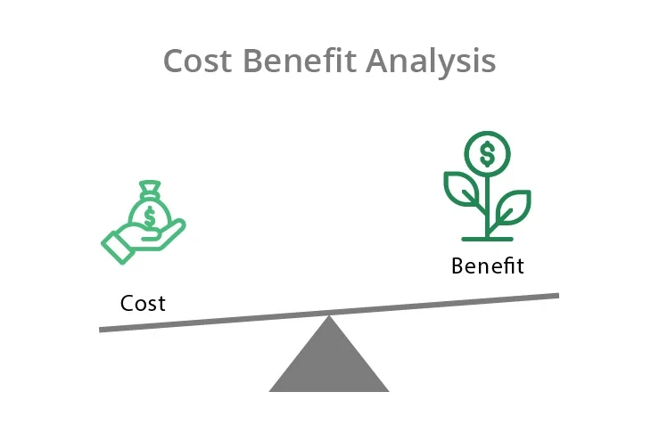
WECOD (Wind Energy Conversion Overlay District)
Example:
Farmer STAR would need to submit a completed application including an:
Economic Cost Benefit Analysis
includes, but not limited to:
Impact of the project on local and state economy
Amount of property taxes to be generated
Amount of sales taxes to be generated
Number of permanent jobs gained and estimated payroll
Impact on property values
Wind Farm Regulations 2021
Public Hearing Presentation

Slide 18
WECOD (Wind Energy Conversion Overlay District)
Example:
Farmer STAR would need to submit a completed application including an:
Environmental Assessment
includes, but not limited to:
Must follow United States Fish and Wildlife Service Land Based Wind Energy Guidelines
Impact on wildlife and wildlife habitat
Impact on soil erosion, and water quality
Noise levels, shadow flicker and blade glint
Wind Farm Regulations 2021
Public Hearing Presentation

Slide 19
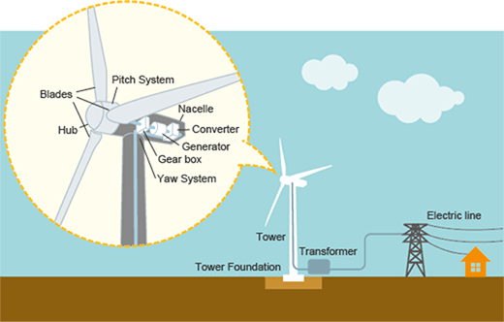
WECOD (Wind Energy Conversion Overlay District)
Example:
Farmer STAR would need to submit a completed application including a:
Description of Turbine(s)
includes, but not limited to:
Type of Turbine, Model number
Size of tower, blades, foundation, etc.
Construction Materials
Color Scheme
Performance, safety, and noise characteristics
Wind Farm Regulations 2021
Public Hearing Presentation

Slide 20
WECOD (Wind Energy Conversion Overlay District)
Example:
Farmer STAR would need to submit a completed application including a:
Traffic Plan
includes, but not limited to:
Anticipated volume of traffic during/ after construction
Routes for oversized and heavy equipment
Method of assurance regarding road repair to public entities
All impacts to the transportation network should be mitigated to the maximum extent practicable
Wind Farm Regulations 2021
Public Hearing Presentation

Slide 21
WECOD (Wind Energy Conversion Overlay District)
Example:
Farmer STAR would need to pay all associated costs including:
Pay Fees
includes, but not limited to:
Public Notice Fees
Costs of completing application documentation
Review fee determined by County Commission
Wind Farm Regulations 2021
Public Hearing Presentation

Slide 22
Notice shall be given to:
WECOD (Wind Energy Conversion Overlay District)
Example:
County will notify the following when public hearings occur on Farmer STAR’s behalf:
Notice Procedures
includes, but not limited to:
All property owners within the proposed WECOD
All property owners within 1000’ of the boundary of WECOD
Newspaper with circulation in their area including a locality map
Columbia Daily Tribune
Centralia Fireside Guard
Boone County Journal
Wind Farm Regulations 2021
Public Hearing Presentation

Slide 23
WECOD (Wind Energy Conversion Overlay District)
Example:
Farmer STAR would need to pass Commission Approval Standards including demonstrating:
Natural and Biological Resources
includes, but not limited to:
Turbines should not be located in areas that have a large potential for biological conflicts
Avoid large intact areas of native vegetation that haven’t been disturbed by man made developments
Avoid areas that would interfere with important wildlife migratory corridors and staging areas.
Wind Farm Regulations 2021
Public Hearing Presentation

Slide 24
WECOD (Wind Energy Conversion Overlay District)
Example:
Farmer STAR would need to pass Commission Approval Standards including demonstrating:
Visual Impacts
includes, but not limited to:
Avoid sites that are visible from scenic byways, scenic overlooks, public parks, Conservation Areas, and Wildlife Refuges
Supporting structures, roads, and fences on the site should be minimized
Turbines should appear similar and shall be a shade of white
Wind Farm Regulations 2021
Public Hearing Presentation

Slide 25
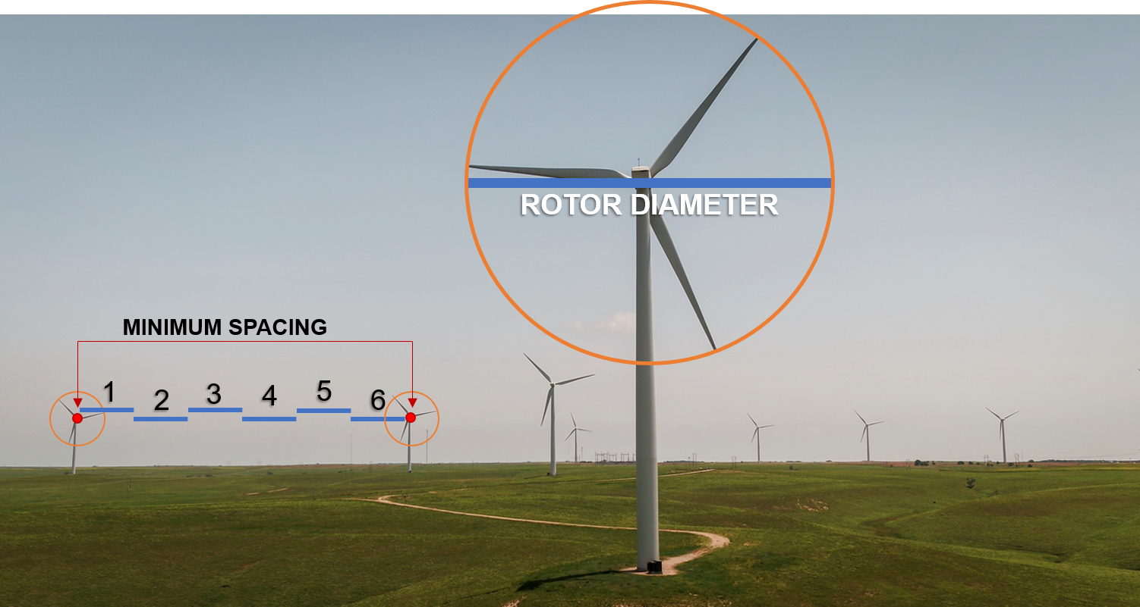
WECOD (Wind Energy Conversion Overlay District)
Example:
Farmer STAR would need to pass Commission Approval Standards including demonstrating:
Visual Impacts
includes, but not limited to:
Each turbine shall maintain a minimum spacing of six (6) times the diameter of its rotor from any other turbine
Intra-project power lines having a voltage of 34,500 volts or less shall be buried
Transformers and other electric equipment should be hidden from view
Wind Farm Regulations 2021
Public Hearing Presentation

Slide 26
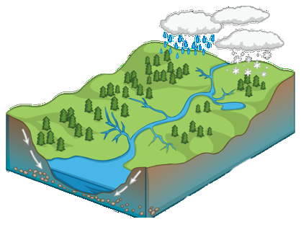
WECOD (Wind Energy Conversion Overlay District)
Example:
Farmer STAR would need to pass Commission Approval Standards including demonstrating:
Soil Erosion and Water Quality
includes, but not limited to:
Avoid construction activities on slopes that are steep or susceptible to erosion
Improved private access roads and construction staging areas should be kept to a minimum
One-lane private access roads are recommended
The number and size of staging areas should be minimized
Wind Farm Regulations 2021
Public Hearing Presentation

Slide 27
WECOD (Wind Energy Conversion Overlay District)
Example:
Farmer STAR would need to meet siting and performance standards including:
Noise Management
includes, but not limited to:
Must meet established standards for noise
Standards regarding noise level are upheld and have maximum limitation
Project owner shall provide an acoustical study that shall demonstrate compliance with the regulatory noise standard
Wind Farm Regulations 2021
Public Hearing Presentation

Slide 28
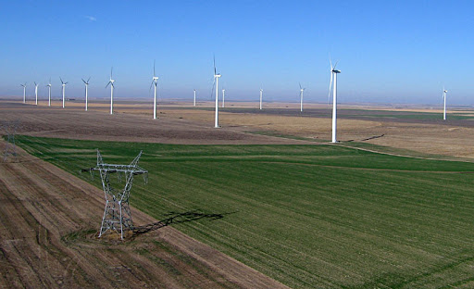
WECOD (Wind Energy Conversion Overlay District)
Example:
Farmer STAR would need to meet siting and performance standards including:
Visual Impacts
includes, but not limited to:
Turbines shall have the same number of rotor blades, spinning in the same direction
Turbines should have the same height from blade tip to the ground
Clusters of machines shall be limited to no more than 12 machines per cluster.
The maximum height of the turbines should be 355 feet.
Outdoor storage is generally not permitted, except during construction
Uniform Color
Uniform Height
Uniform Distance
Wind Farm Regulations 2021
Public Hearing Presentation

Slide 29
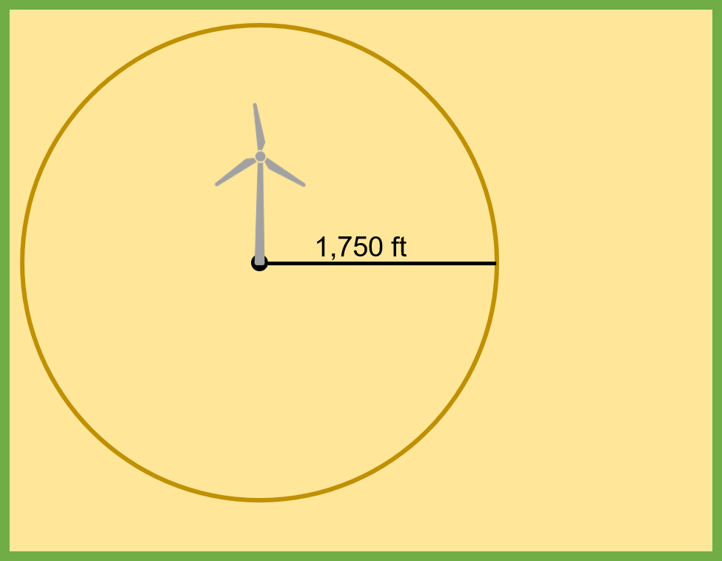
WECOD (Wind Energy Conversion Overlay District)
Example:
Farmer STAR would need to meet siting and performance standards including:
Safety
includes, but not limited to:
not to scale
Turbine shall maintain a minimum clearance of 15-feet from the ground
Individual wind turbines shall be set back 1,750-feet from all public road rights of way
Individual wind turbines shall be set back 1,750-feet from all property lines
Planning and Zoning commission considered several setback requirements as a balance between safety, equity, and other community concerns
Wind Farm Regulations 2021
Public Hearing Presentation

Slide 30
WECOD (Wind Energy Conversion Overlay District)
Example:
Farmer STAR would need to meet siting and performance standards providing:
Financial Security
Ensures that the project owner provides adequate funding to pay the costs associated with:
Decommissioning and Site Reclamation
Removal of individual turbines and accessory structures in the event of abandonment.
Tax dollars are not to be spent on reclaiming WECOD areas
Security = Estimated Decommissioning and Site Reclamation Cost x (1.5)
Wind Farm Regulations 2021
Public Hearing Presentation

Slide 31
WECOD (Wind Energy Conversion Overlay District)
Example:
Farmer STAR would need to meet siting and performance standards providing:
Reclamation
Owner Initiated:
When the project has completed its life span, the owner shall abide by County standards to reclaim land. Financial Security will be released.
County Initiated:
If owner has abandoned project, the County may use provided Financial Security to complete the reclamation of land.
Tax dollars are not to be spent on County Initiated Reclamation
Wind Farm Regulations 2021
Public Hearing Presentation

Slide 32
WECOD
(Wind Energy Conversion Overlay District)
CUP
(Conditional Use Permit)
Wind Farm Regulations 2021
Public Hearing Presentation

Slide 33
CUP (Conditional Use Permit)
WECS-C Wind Turbine
CUP
Every turbine and accessory structure must be covered by a Conditional Use Permit –
Applicant must apply for a CUP
The CUP application must provide details specific to the structure's location and conditions
Wind Farm Regulations 2021
Public Hearing Presentation

Slide 34
CUP (Conditional Use Permit)
The applicant would need to provide a wide variety of documentation in addition to the application from the corresponding WECOD for each CUP
including, but not limited to:
Project Owner Information
A detailed Site Plan
Environmental Assessment
Detail Description of Turbine(s) including size, height, rotor material, etc.
A plan for the physical security of the site
Wind Farm Regulations 2021
Public Hearing Presentation

Slide 35
CUP (Conditional Use Permit)
The WECS-C CUP must comply with Section 15 within the Zoning Regulations in addition to the criteria laid out within these regulations.
Conditions
includes, but not limited to:
Limitation on future subdividing of land
Must enter a transportation mitigation agreement with County Commission
Continually comply with U.S. Fish and Wildlife Service Land Based Wind Energy Guidelines
Wind Farm Regulations 2021
Public Hearing Presentation

Slide 36
Failure to Perform
The County Commission shall have the authority, after a public hearing, to remove the WECOD if it determines that no WECS-C have been constructed in the District within a period of ten (10) years from the date of the County Commission Order that established the WECOD.
WECOD
Any approved conditional use permit should be utilized within one (1) year of approval by the County Commission.
An invalidated permit can only be renewed by reapplication and approval as outlined within Section 15 of the Zoning Regulations.
CUP
If an applicant fails to meet any of the criteria outlined within the regulations, then the application shall fail. Whether or not an application meets all requirements is ultimately the decision of the County Commission.
Wind Farm Regulations 2021
Public Hearing Presentation

Slide 37
Thank you
This information can be found on our website
www.showmeboone.com/resource-management/WECOD
This slideshow will be made available online as well as:
Links to the draft Regulations
Wind Farm Frequently Asked Questions
The email address WECOD@BooneCountyMO.org
Written comments may be submitted to Resource Management through April 30, 2021
Wind Farm Regulations 2021
Public Hearing Presentation

